Slide 1
FOLKSONOMY - Analysing tags in CQA sites
Done by:
Students:
Deepika
Annanya
Anshuman
Teaching Assistants:
Ms Suryamukhi,
Ms Ambey Kumari

Slide 2
CONTENTS
DAG Construction
Introduction
Retrieving the groups using Infomap
Goal
Subsumption relationship
Method
Cooccurrence and similarity

Slide 3






Introduction
This Photo by Unknown Author is licensed under CC BY-SA
CQA sites are question answering platforms where users can post a question or answer any posted question.
Tags play a crucial role in CQA sites by facilitating organization, indexing and categorization of the entire post in a few words.
This could either lead to receiving an accurate response for the question or result in receiving no answers.
The choice of tags, thus, directly determines the quality of the response to a post as well as to a large extent the success of the CQA site itself.

Slide 4
Introduction
Questions are usually posted along with some tags
A tag to a question is something that specifies the topic of the question.
Tags help organize the questions and find the other related questions.
Tags are used to reach the target audience.

Slide 5
Introduction
In CQA sites, users are allowed to post questions with tags that helps people recommend the concepts they are searching for.
Companies can use data about what users are adding to produce better ways to structure content, and so help them find what they’re looking for.
We have taken data from the Super User website.
Data consists of 5437 tags and 1246774 records consisting of sentences with the tags.
We generate structure of tags to help people recommend.

Slide 6


Goal
Our goal is to organize the tags in order to understand and perceive relationships between them by constructing a Tag Ontology.
A Tag Ontology is the hierarchical representation of tags and their relationships.

Slide 7



Procedure
1. To retrieve the relationship between the tags :
Understand the Co-occurrence and retrieve the similarity
Understand the Subsumption relationship
2. Forming the groups using infomap detection algorithm
3. Construct an hierarchical ontology using DAG algorithm on each group

Slide 8
Understanding the Co-occurrence and retrieve the similarity
Extract only the popular tags by setting a threshold of the count of individual tags. In project we have set threshold as 30
Get the Co-occurrent tag pairs out of the tags co occurring in each of the post
Extract the tag pairs cooccurring at least a specific n times by setting a threshold.
In this project we set the threshold to 30.

Slide 9



Cooccurrence and similarity
Calculate the google distance on the above extracted tags
Calculate similarity of each co-occurring pair

Slide 10

Subsumption relationship…
Calculate subsumption relationship
Filter the tag pairs for which probability is very less. In project 0.7 is set as probability threshold.

Slide 11
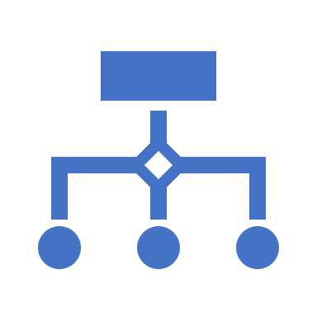
Retrieving the groups using Infomap
Infomap site is used to input the tag pairs with weights and retrieve the groups formed.
https://www.mapequation.org/infomap/

Slide 12
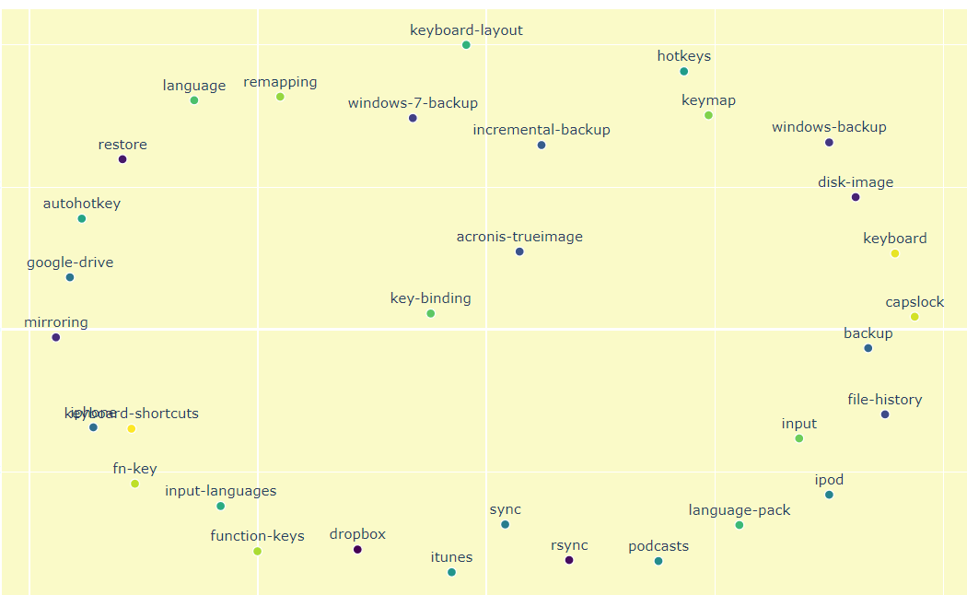
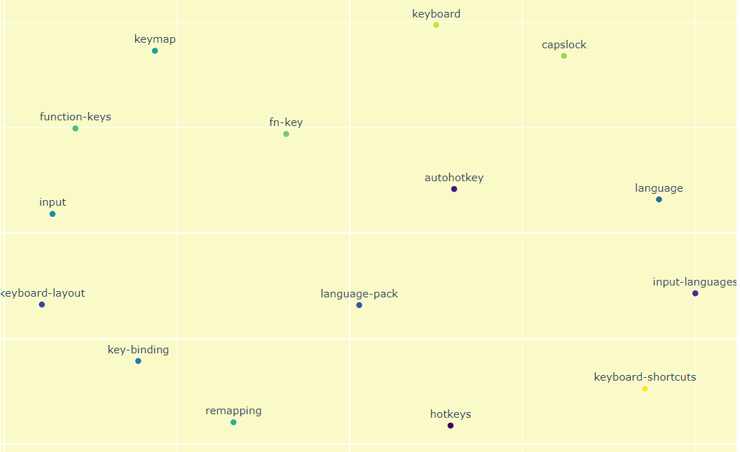

Groups retrieved

Slide 13
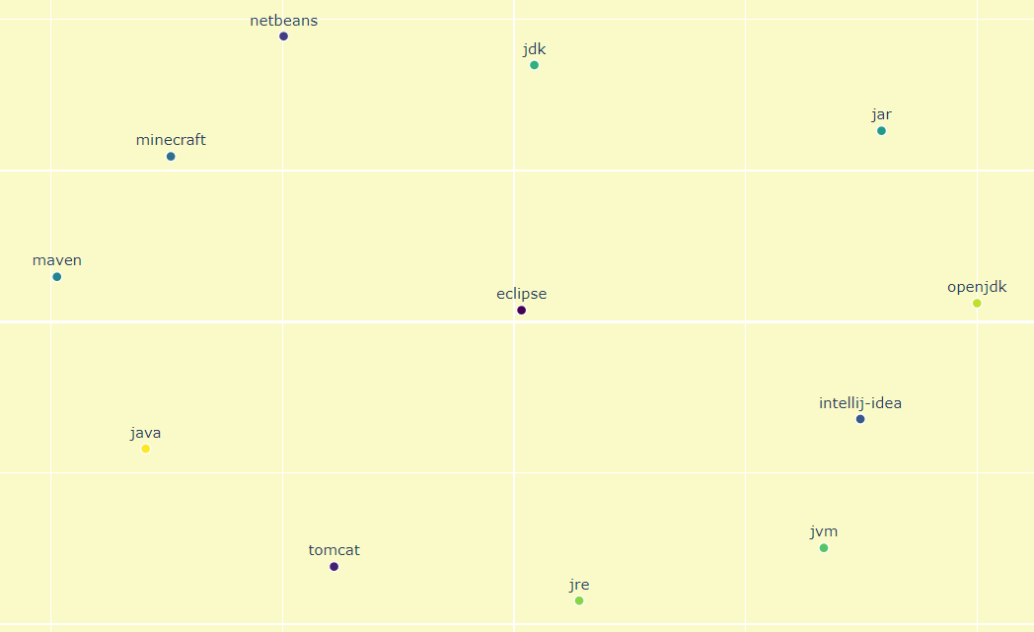

Slide 14

DAG Construction
Entropy of each tag is calculated.
From each group the tags are taken in descending order of their entropies and the subsumption pairs are attached for each of the tags.

Slide 15
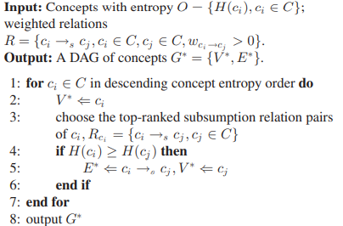
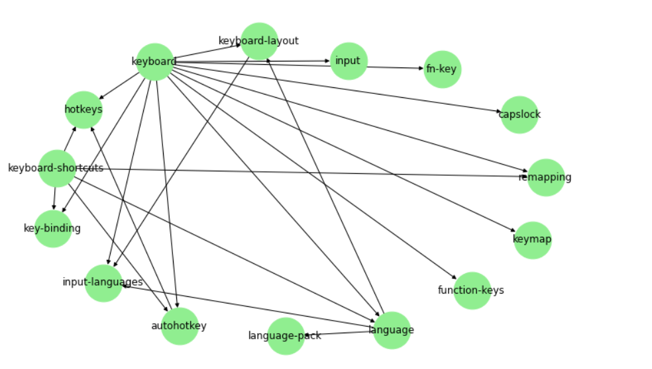
DAG Algorithm

Slide 16
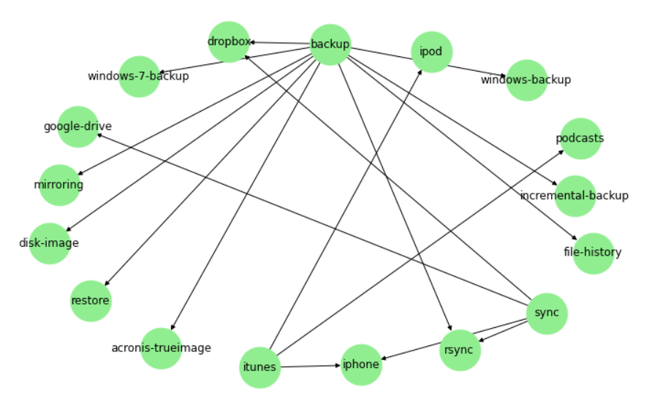
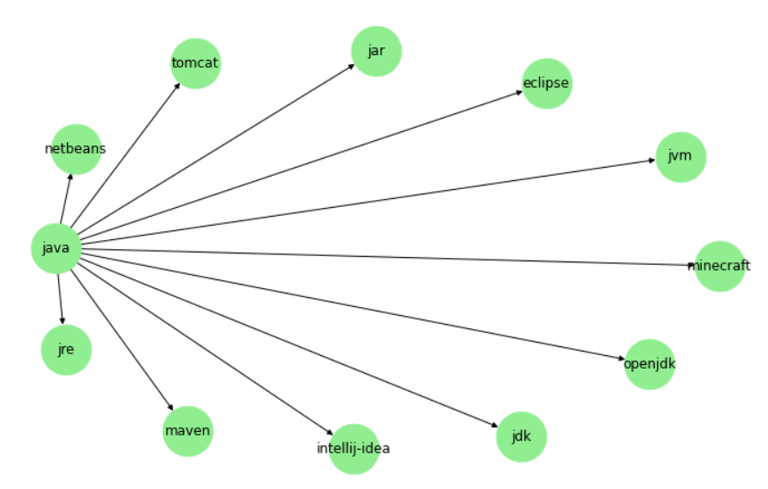

Slide 17

Conclusion
1. In this project, we have introduced a systematic solution for automatically constructing a visual ontology from folksonomy based images.
2. The constructed visual ontology consists of rich concept set, pairwise concept relationships and hierarchical structure of concepts.
3. The learned models corresponding to the concept nodes can recognize new posts to update the ontology.

